Slide 1

BC, EC and OC
Metrics, emissions and trends
Jeroen Kuenen, Hugo Denier van der Gon, Bas Henzing, Antoon Visschedijk
EC emissions from diesel-fuelled vehicles, 2009

Slide 2
Contents
BC and EC: different metrics and terminology
EC estimates for Europe and their trends & spatial distribution

Slide 3
BC terminology
Black carbon (BC) sources are incomplete combustion processes , BC is particulate matter, it contains a lot of carbon and it is primary.
US, EPA (2012) A solid form of mostly pure carbon that absorbs solar radiation (light) at all wavelengths. BC is the most effective form of PM, by mass, at absorbing solar energy, and is produced by incomplete combustion.
IPCC (2013) Operationally defined aerosol species based on measurement of light absorption and chemical reactivity and/or thermal stability. It is sometimes referred to as soot.
Petzold et al. (2013) A qualitative description when referring to light absorbing carbonaceous substances in atmospheric aerosol.

Slide 4
BC measurable properties
Method defined terminology for black carbon (Bond et al., 2013)
Refractory with vaporization temperature near 4000 K [Schwarz et al., 2006].
Strong visible light absorption at 550 nm [Bond and Bergstrom, 2006.
Aggregate morphology [Medalia and Heckman, 1969].
Insolubility in water and common organic solvents [Fung, 1990].
techniques based on the measurement of light absorption,
techniques based on the measurement of thermal stability of carbon.

Slide 5
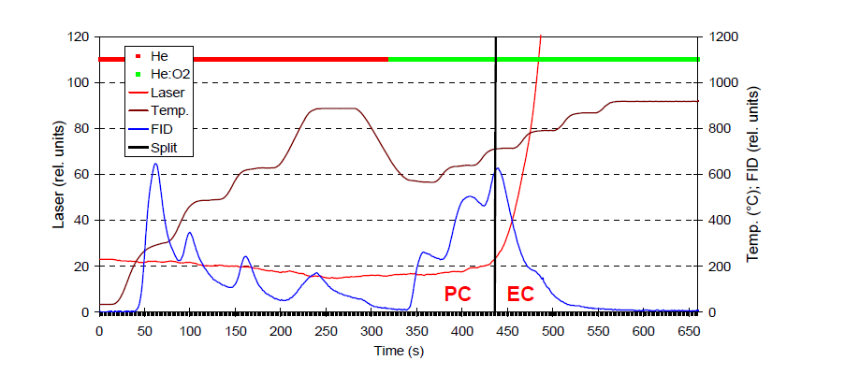
Evolving carbon methods – EC-OC methods
Thermal optical methods
Aerosol on filter is exposed to two different atmospheres (red and green).
Carbon evolving from filter in 2nd green cycle is named EC
    it is material with the refractory property of BC!
What is measured with this method is mass of element C

Slide 6
Absorption Photometers (Black Smoke, Aethalometer, PSAP, MAAP, etc.)
Light transmission or reflection is measured while filter is continuously loaded with aerosol. The reduction in light is attributed to absorbing property of BC.
What is measured with this method is at best light absoption
Absorption photometers are calibrated against the previously mentioned evolving carbon methods to obtain a mass metric.
This calibration constant (!) is frequently referred to as MAC (Mass-specific Absorption Cross section.
When reporting the mass should be reported as Equivalent BC (EBC)
Traditionally mass concentrations obtained with absorption photometers are reported as BC, leading to confusion

Slide 7
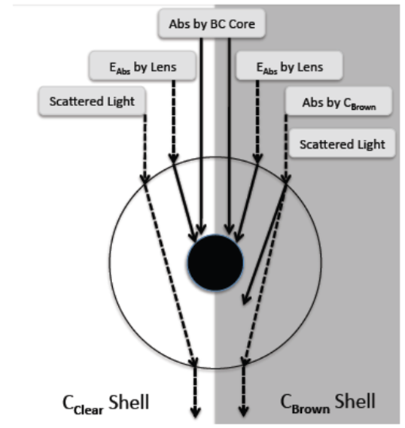
Aerosol aging
EC is measured as refractory C. EC is thus not changing after emission
Light absorption is however not constant after emission.
    [Conc EC]=MAC⁻¹*abs.coef
If the mass is EC and absorption increases →
MAC must increase after emission!
But they are internal calibration factors
When reporting data: EBC and give MAC used!

Slide 8
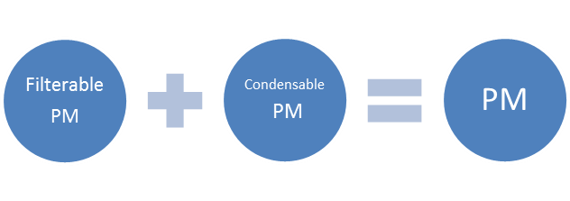
Condensables
Particulate matter (PM) consists of a filterable fraction (FPM) and a condensable fraction (CPM).
Filterable PM is directly emitted:
Solid or liquid
Captured on filter
PM₁₀ or PM_{2.5}
Condensable PM is in vapor:
Reacts upon cooling and dilution
Forms solid or liquid particle
Always PM_{2.5} or less
No black or elemental carbon!

Slide 9
Emissions and trends
For modellers, there is a need for a consistent and complete emission inventory for the main pollutants, but also PM including its components!
Currently, our inventories sometimes do not always meet their high expectations ☺

Slide 10
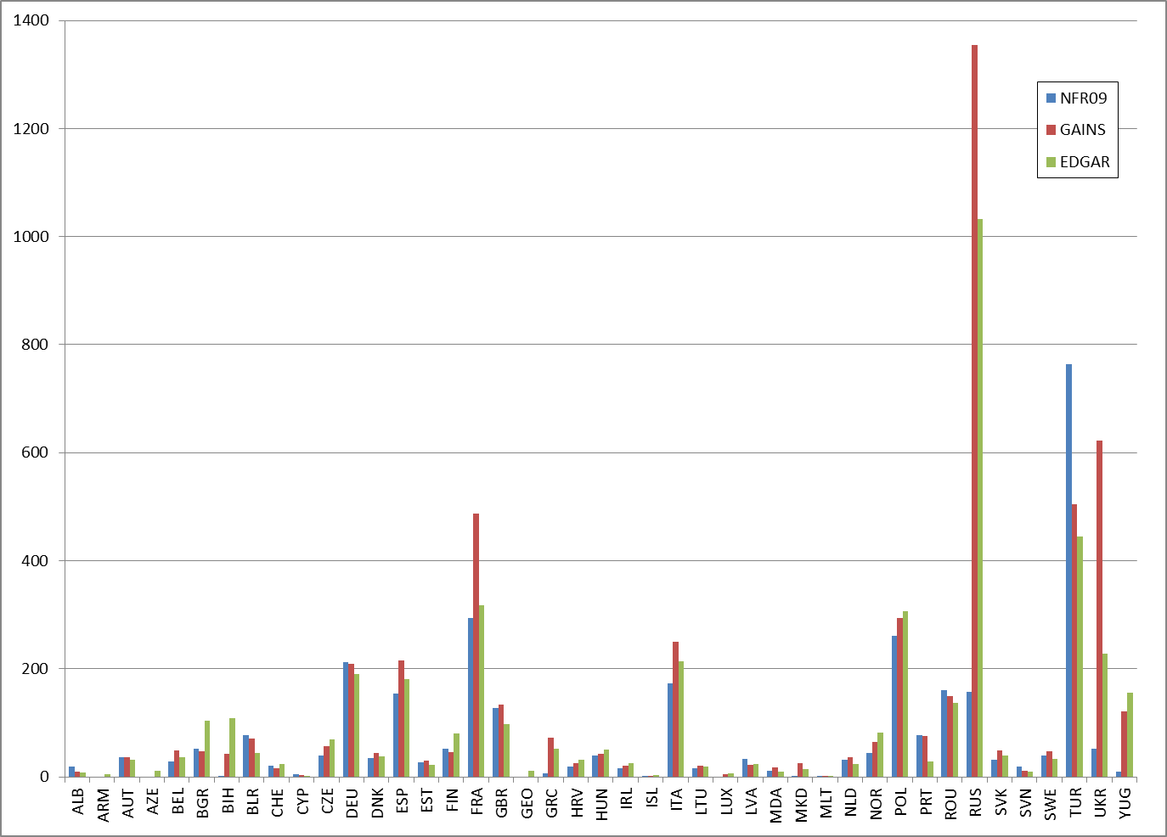
Comparison of national totals of PM10 emissions from various sources (2008, kton)

Slide 11

EC/OC emissions in TNO_MACC-III inventory – methodology in a nutshell
Starts from reported PM10 & PM2.5 per source sector (from reporting year 2013) – completed with IIASA GAINS estimates where needed
Some modifications/additions made for consistency/completeness (e.g. agr. waste burning, wood combustion, agricultural NOx/VOC)
Calculation of PM_coarse as PM10-PM2.5, PM _fine = PM2.5
Breakdown of PM_coarse and PM_fine per source sector in IIASA GAINS subcategory/fuel combinations (>200 sectors)
Estimation of EC and OC fractions for each of the sectors, based on data collection from various sources, expert judgement, etc.
Consistent spatial distribution using various proxies incl. point source information
Work is update of TNO_MACC-II emission inventory (all the details in Kuenen et al., ACP, 2014)

Slide 12
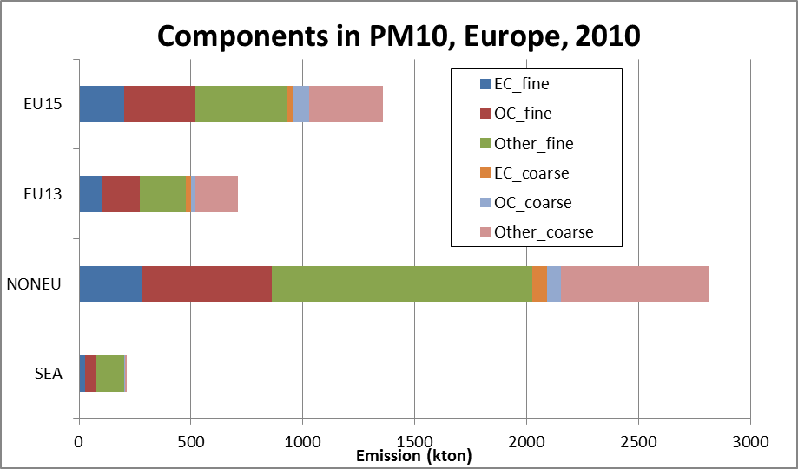
+NOR/CHE

Slide 13
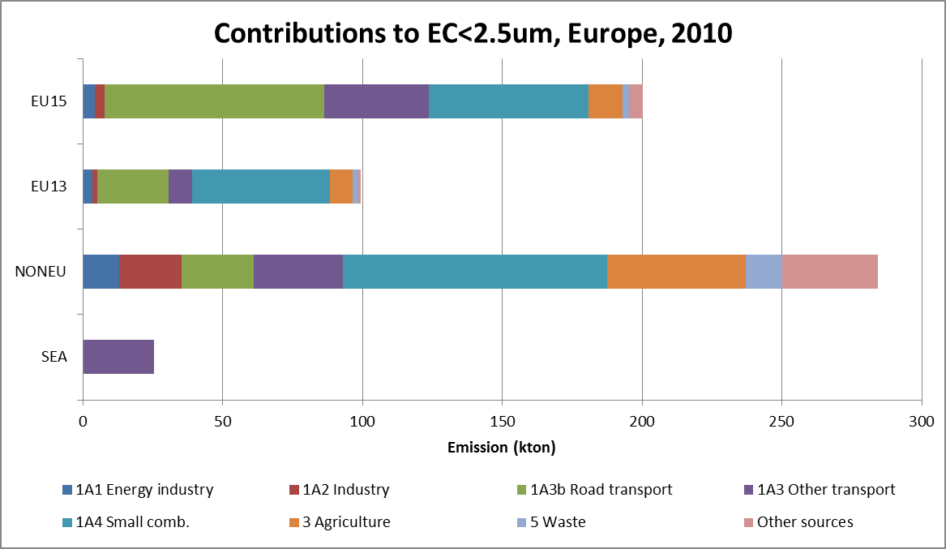
Sources of elemental carbon
+NOR/CHE

Slide 14
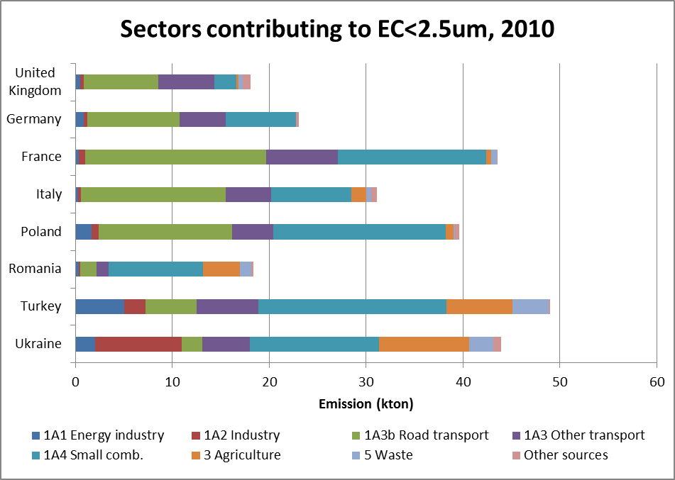
But countries can be quite different!
Notes:
Agriculture = agricultural waste burning

Slide 15
Gridded EC, 2009, all sectors

Slide 16
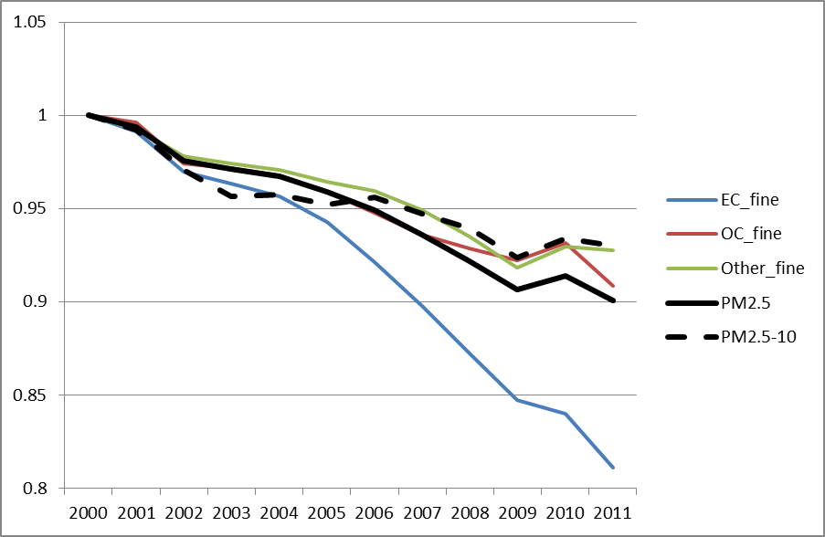
Trends
Reducing trend in EC stronger than trend in PM2.5, since policy measures usually affect combustion sectors

Slide 17
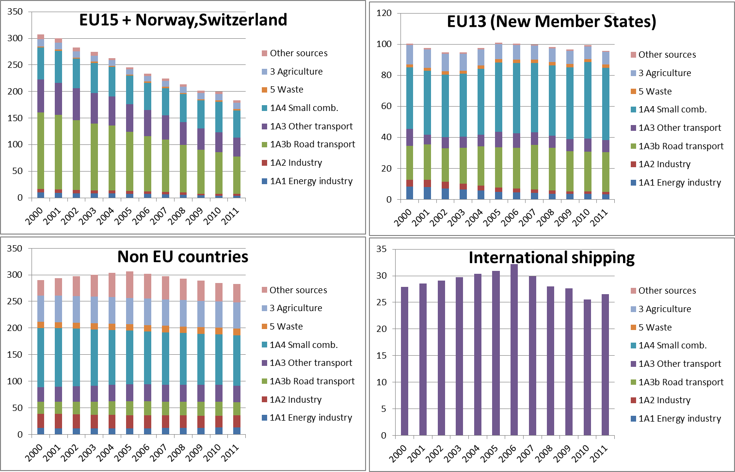

Slide 18
Reduction in 2011 compared to 2000 – TNO_MACC-III inventory inventory

Slide 19
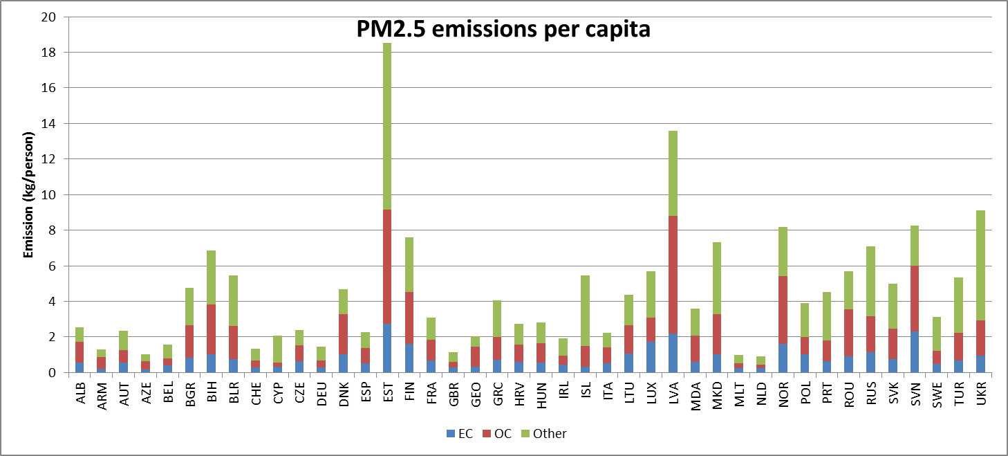
Data checking
By looking at emissions per capita, outliers can be identified and looked at in more detail

Slide 20
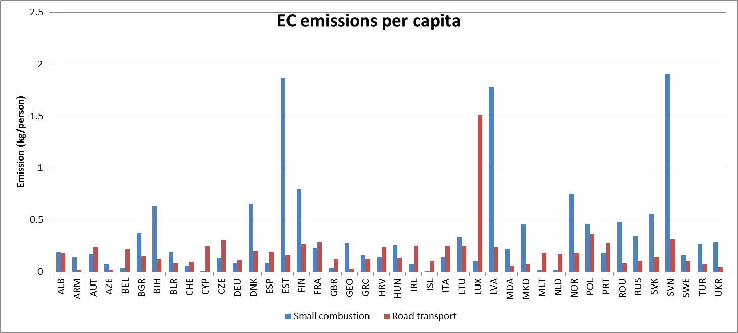
Per sector
Small combustion (33% of total EC), road transportation (21%)
  Climatological differences & fuel types for residential combustion
  Diesel vs. gasoline in road transportation

Slide 21
Conclusions
To assess the impact of PM and its components, understanding and quantification is a key first step!
It is very important that we clearly distinguish between EC and BC (and OC) to avoid confusion
  Black carbon: optical measurement, recalculated to mass, not conservative as optical properties may change during aging and transformation!
  Elemental carbon: mass based analysis, conservative
TNO_MACC-III inventory provides gridded EC & OC emissions calculated consistently for UNECE-Europe (AQ modelling input)
  Decrease in overall EC since 2000 but not for all countries/sectors!
  Variations per country/sector not all understood – requires further work & checks

Slide 22

References and acknowledgement
Kuenen, J. J. P., Visschedijk, A. J. H., Jozwicka, M., and Denier van der Gon, H. A. C.: TNO-MACC_II emission inventory; a multi-year (2003–2009) consistent high-resolution European emission inventory for air quality modelling, Atmos. Chem. Phys., 14, 10963-10976, doi:10.5194/acp-14-10963-2014, 2014.
Nordmann, S., et al. Atmospheric black carbon and warming effects influenced by the source and absorption enhancement in central Europe, Atmos. Chem. Phys., 14, 12683-12699, doi:10.5194/acp-14-12683-2014, 2014
Genberg, J., et al. Light-absorbing carbon in Europe – measurement and modelling, with a focus on residential wood combustion emissions, Atmos. Chem. Phys., 13, 8719-8738, doi:10.5194/acp-13-8719-2013, 2013.

