Slide 1
The UK Emissions Projections
TFEIP/EIONET Annual Meeting - Projections Expert Panel
12th May 2015
Yvonne Pang

Slide 2
What’s in this presentation
Background on UK projections
Applications of the UK projections
Sector example: Road transport projections

Slide 3
Background on UK projections
The UK National Atmospheric Emissions Inventory (NAEI) programme is funded by
The NAEI project team is made up of a consortium led by Ricardo-AEA
supported by the Centre for Ecology and Hydrology, Rothamstead research, Aether, SKM-Enviros and AMEC

Slide 4
Background on UK projections – Coverage
The UK projections model calculates projected emissions for
NOx, SO₂, NH₃, NMVOC, PM₁₀, PM_{2.5}, BC, CO, benzene, arsenic, cadmium, nickel, lead, benzo[a]pyrene
2015, 2020, 2025, 2030 (Road Transport out to 2035)
Same detailed disaggregation as the UK National Atmospheric Emission Inventory (NAEI)

Slide 5
Background on UK projections – Data Sources
The key input data include:
UK National Atmospheric Emission Inventory (NAEI) - baseline
The Department of Energy and Climate Change (DECC) Energy and Emissions Projections model (EEP)
The Department for Transport (DfT) traffic forecasts
Updated projections of livestock numbers and fertiliser use to 2030 using data derived from the FAPRI agricultural model by Queens University Belfast on behalf of Defra
Process operators and trade associations

Slide 6
Background on UK projections – Methods and Assumptions
Methodology
E_{proj} = (A_{NAEI Baseyear} * AD) * EF_{proj}
Where E = emission, A = activity, AD = activity driver and EF = emission factor
General Assumptions
Only consider firm and funded polices as described in DECC EEP
All operators comply with legislation
New abatement is applied to sources in order to meet the limits imposed by regulations or in response to the impacts of trading mechanisms

Slide 7
Applications of the UK projections
To support UK Government with
Reporting and tracking progress towards emission reduction targets (NECD and Gothenburg Protocol)
Assessing compliance with the EU Air Quality Directive
Formulation and assessment of national policies on air pollution
UK Projections are used in a wide range of policy tools:
Pollution Climate Model
Multi-Pollutant Measures Database (MPMD)
UK Integrated Assessment model (national and urban scale modelling)
Regional scale air quality modelling

Slide 8
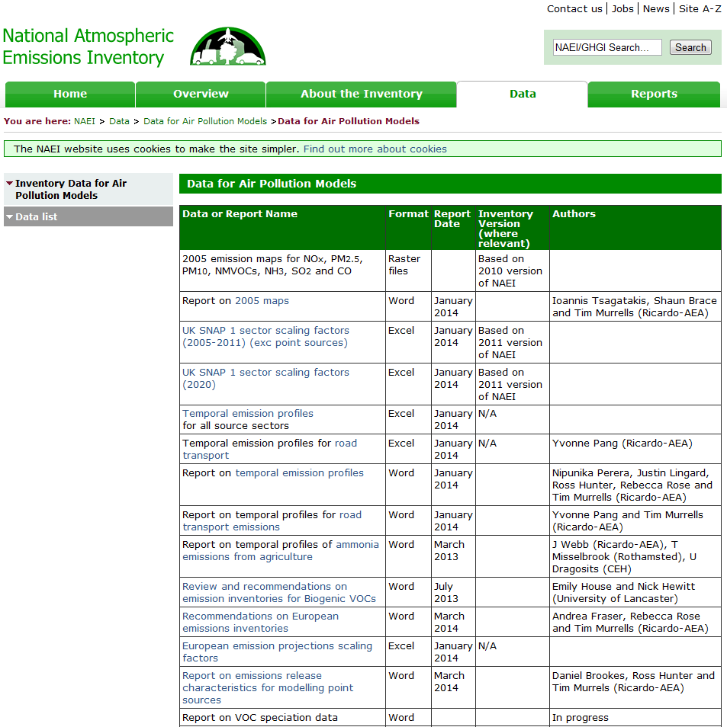
Good Practice
Working closely with other stakeholders and AQ community
Make additional information available for AQ modellers
To do projection on a consistent basis
To be launched on the NAEI website in the future →

Slide 9
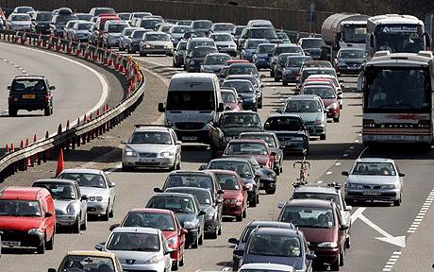
Sector example: Road transport projections

Slide 10
Overview (1)
Pollutants coverage
NOx, NMVOCs, SO₂, NH₃, PM₁₀, PM_{2.5}, benzene, CO, metals
non-CO₂ GHG (CH₄, N₂O)
Vehicle types
Cars, LGVs, Rigid and artic HGVs, Buses and coaches, Motorcycles
Euro standard system (up to Euro 6/VI)

Slide 11
Overview (2)
Emissions from each vehicle type =
Emission factor (g/km) x Projected activity (vehicle km travelled)
Fleet composition:
By fuel type
By age mix → Euro standard
By engine size/ vehicle weight
By technology
EMEP/EEA Emission Inventory Guidebook / COPERT 4
DfT/TRL (2009)

Slide 12
Traffic projections – Data Sources
Great Britain
Department for Transport (vehicle-km)
Up to 2035 (recently 2040)
By vehicle, road, area type and Government Office Region
Derived from the DfT’s National Transport Model based on UK transport policy
London
Transport for London
Growth factors for 2021 and 2031
Northern Ireland
Assume same as GB’s growth rates

Slide 13
Fleet composition assumptions
Fleet turnover model → proportion of vehicle km by Euro Standard
Vehicle sales projections
DfT for Cars and LGVs - Conventional (diesel/ petrol), full hybrid, plug-in hybrid, Electric
Correlation b/c historical vehicle sales (and total vehicles on road) against vehicle-km travelled data → Use traffic projection as a proxy to project vehicle sales
Vehicle survival rates
Relative mileage with age
Fleet composition data for London – Transport for London
Taking into account the impact of Low Emission Zone (LEZ), TfL Bus measures, Taxi age limit

Slide 14
Sensitivity Analysis
Varying input assumptions e.g. traffic growth, diesel penetration rate, NOx assumptions for Euro 6 diesel cars and LGVs

Slide 15
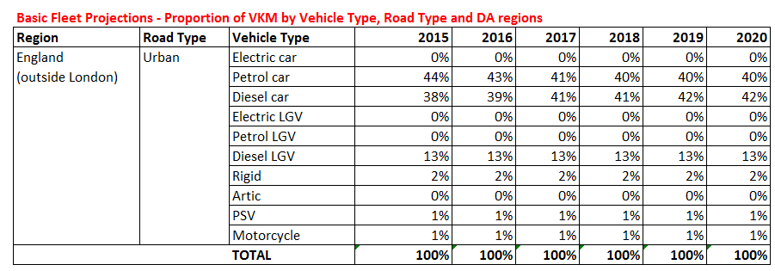
Output
Emissions projections by vehicle type and road type
Fleet composition projections data
NAEI Website (http://naei.defra.gov.uk/)
Input for the Emission Factors Toolkit for local air quality assessment http://laqm.defra.gov.uk/review-and-assessment/tools/emissions-factors-toolkit.html

Slide 16
Yvonne Pang
Thank you
Ricardo-AEA Ltd
The Gemini Building
Fermi Avenue
Harwell, Didcot,
OX11 0QR
01235 75 3444
yvonne.pang@ricardo-aea.com
www.ricardo-aea.com

Slide 17
Emission Factors Toolkit for local air quality assessment
http://laqm.defra.gov.uk/review-and-assessment/tools/emissions-factors-toolkit.html

