Slide 1


Global and regional black carbon mitigation opportunities
Zig Klimont
(klimont@iiasa.ac.at)
Improving BC Emissions Estimates and Abatement
TFEIP/US-DOE Workshop
Milan, Italy, May 13-14, 2015

Slide 2
Glossary
GAINS – Greenhouse Gas and Air Pollution Interactions and Synergies Model, integrated assessment model developed at IIASA, Laxenburg, Austria (http://gains.iiasa.ac.at)
ECLIPSE – Evaluating the Climate and Air Quality Impacts of Short‐Lived Pollutants, European Union FP7 project
(http://eclipse.nilu.no)
Scenarios:
  CLE – current legislation
  MTFR – maximum technical reduction
  NFC – no further control
  2ºC CLE – climate stabilization scenario
  RCP – Representative Concentration Pathways; global scenarios used in IPCC 5th assessment report

Slide 3
Change in spatial distribution of BC emissions between 2005 and 2030; GAINS current legislation

Slide 4
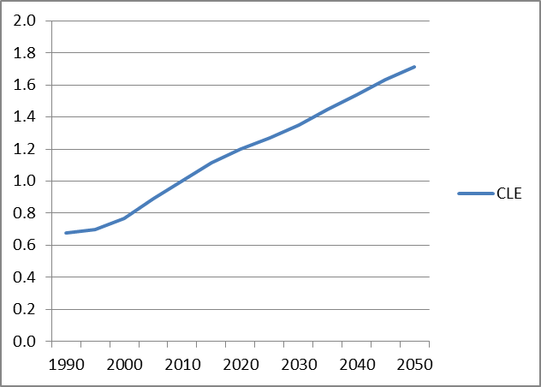
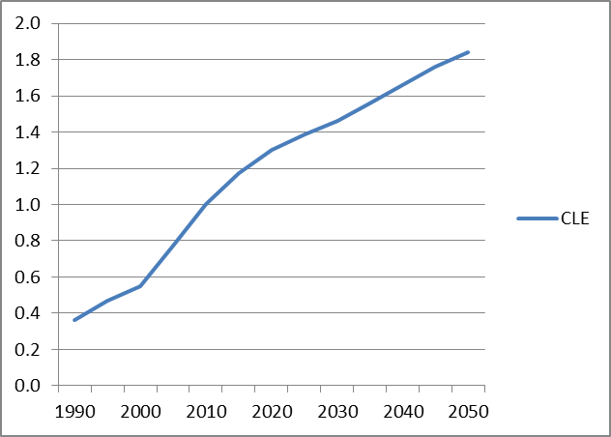
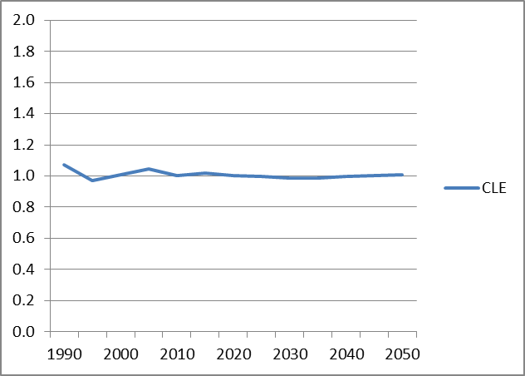
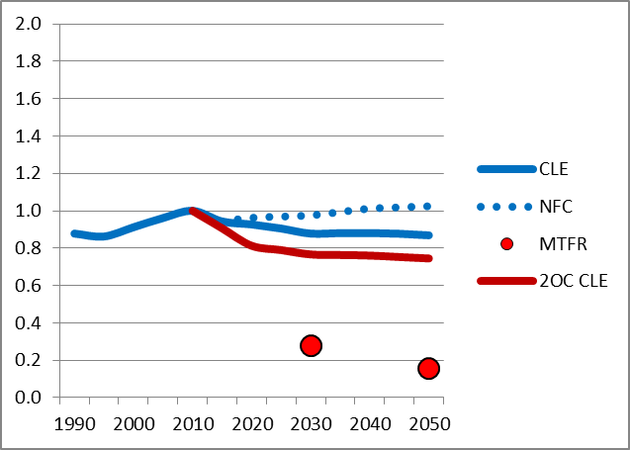
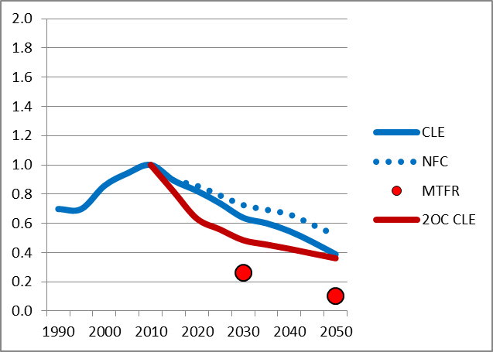
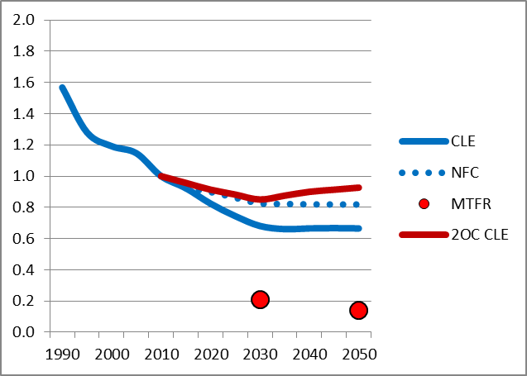
Current legislation vs alternative scenarios
Relative changes to 2010, GAINS ECLIPSE V5 (Klimont et al., in prep)
North Am.
& Europe, incl. Russia
World
China+
CO₂
Black Carbon

Slide 5
Impact of current and planned legislation on BC emissions in the EU28, kt
-49%
-58%
-73%
Source: IIASA – GAINS model runs during TSAP work (2013)

Slide 6
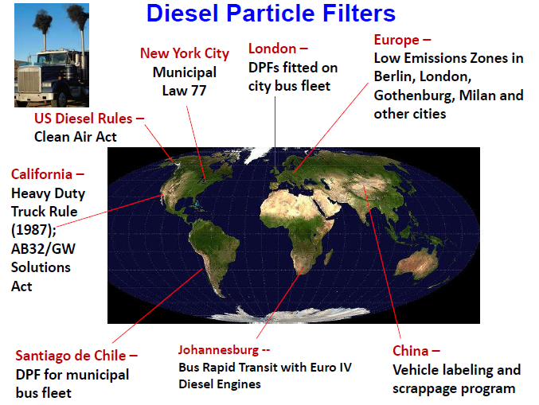

Slide 7
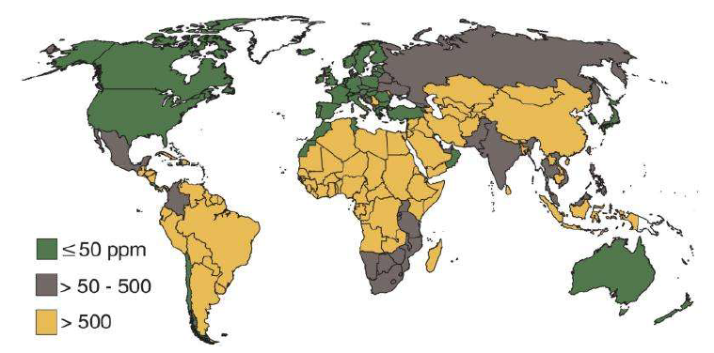

Some technologies deliver only when other pieces of legislation are timely implemented
Sulfur content of diesel fuel

Slide 8
Potential to reduce BC in the EU-28 by 2025 via introduction of Eco-design, kt
-11%
-20%
-47%
-57%
Source: IIASA – GAINS model runs during TSAP work (2013)

Slide 9
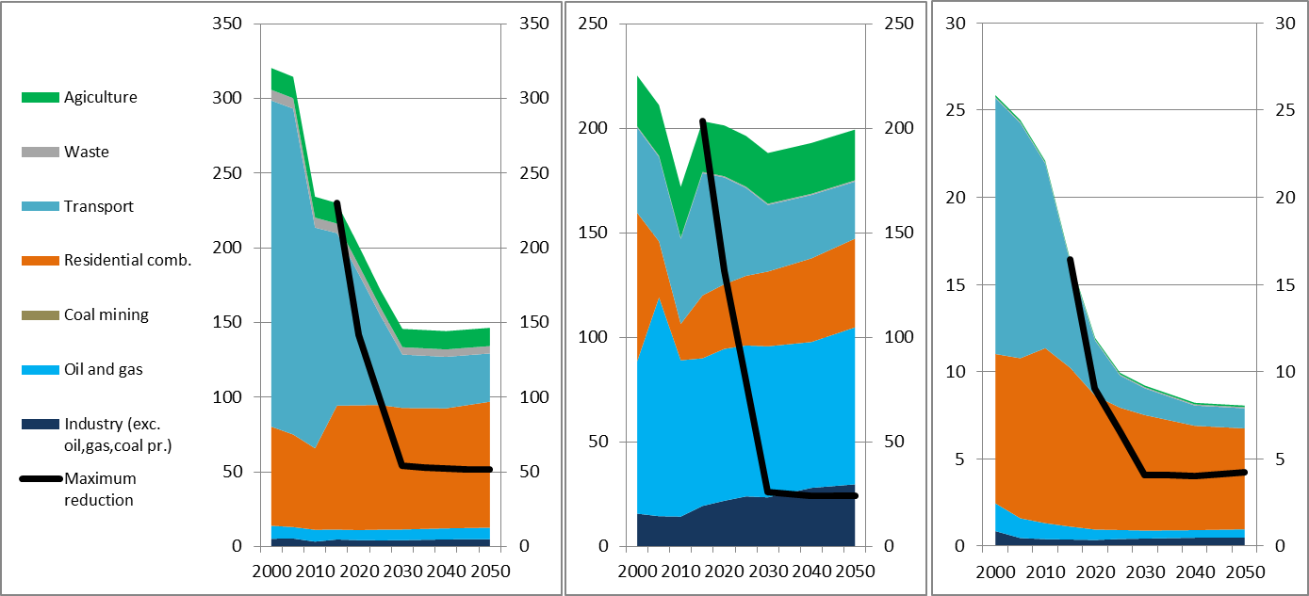
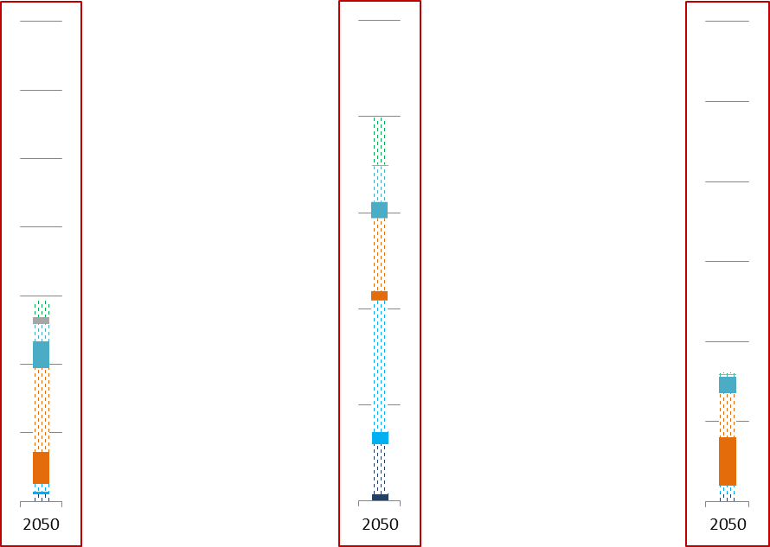
GAINS BC baseline and mitigation potential for Arctic Council countries, kt BC
US & Canada
Russian Federation
Nordic Countries
Mitigation potential by 2050
Source: GAINS model; ECLIPSE V5 scenario

Slide 10
Regional distribution of mitigation by key measures
(about 90% of the whole potential) [kt BC by 2030]
Relative
contribution
24%
40%
4%
16%
6%
10%
Source: GAINS model; ECLIPSE V5 scenario

Slide 11
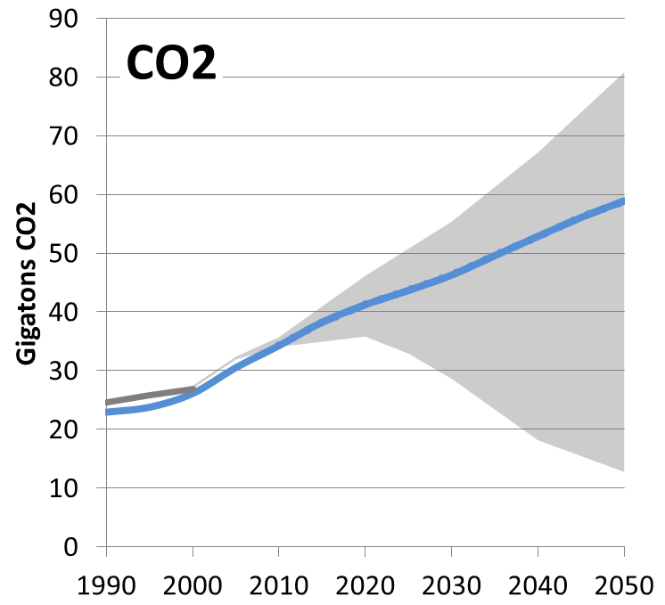
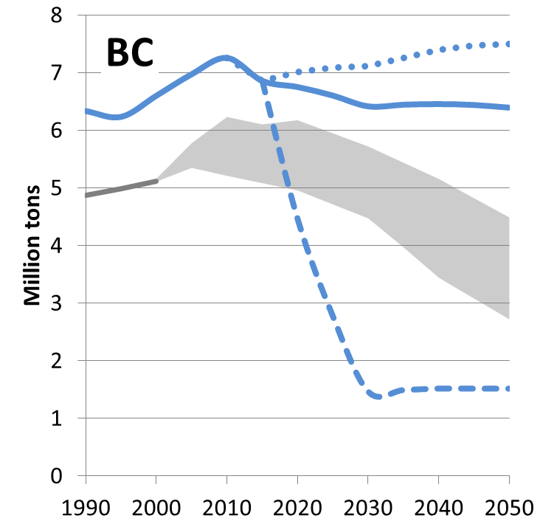
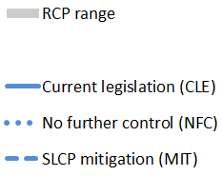
Range of future global emissions
GAINS policy scenarios vs RCP (Klimont et al., in prep)
Source: GAINS model; ECLIPSE V5 scenario

Slide 12
Summary comments
There are a number of proven technologies addressing key emission sources….BUT there are several challenges, e.g.:
Developing ‘clean stove’ technology matching region-specific expectations and challenges
Successful implementation requires integration with other policies, e.g.,
  Low sulfur diesel required for particle filters
  Monitoring and maintenance programs
Market forces alone are not likely to drive the change; additional regulation and incentives needed
Identifying successful policy framework and financial schemes allowing for fast implementation

Slide 13
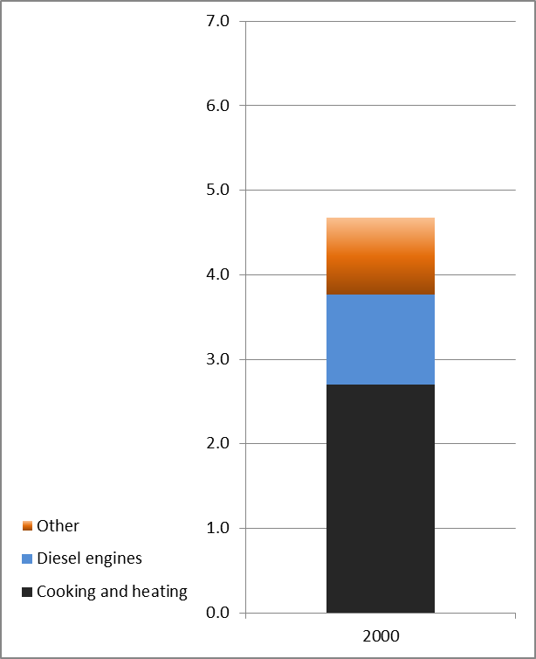
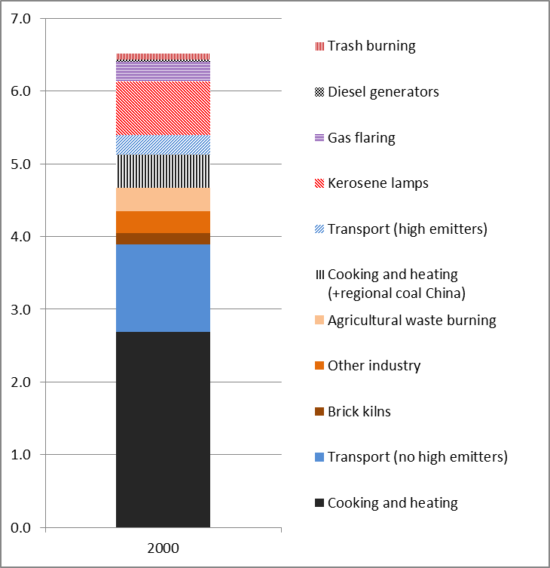
Global BC emissions in 2000, Tg BC
(excluding forest and grassland fires)
Source: GAINS model – ECLIPSE results (Klimont et al., in preparation)
Range of global estimates shown in Bond et al., 2013
GAINS; excluding ‘new/re-estimated’ sources
GAINS; all sources

