Slide 1
Arctic Black Carbon: Reduction of Black Carbon from Diesel Sources
Application of Diesel Emission Inventory Tools in Murmansk
Teresa Kuklinski
U.S. Environmental Protection Agency
Meredydd Evans, Nazar Kholod
Pacific Northwest National Laboratory,
Battelle Memorial Institute
Vladimir Malyshev, Eugene Gusev, Murmansk State Technical University

Slide 2
Overview: Arctic Black Carbon: Reduction of Black Carbon from Diesel Sources
Part of the Arctic Black Carbon Initiative (ABCI) which is an international cooperative effort launched in 2009 with the goal to reduce black carbon in and around the Arctic.
ABCI US Government Effort:
EPA: diesel emissions
USDA/Forest Service: forest fires and agricultural burning
Department of Energy (DOE): residential and district heating and power stations
Notes:
ABCI - 1) filling information gaps, 2) identifying barriers to implementation and developing approaches to overcome them, 3) demonstrating and evaluating mitigation options, and 4) where possible, laying the groundwork to quantify the climate and, public health benefits of black carbon mitigation strategies.

Slide 3
Overview: Arctic Black Carbon: Reduction of Black Carbon from Diesel Sources
Reporting to The Arctic Council’s Arctic Contaminants Action Program (ACAP) Short-Lived Climate Forcers and Contaminants (SLCF) Expert Group (EG) [Formerly Project Steering Group (PSG)].
EPA Partners
Battelle Memorial Institute with WWF, Russia and Murmansk State Technical University
NEFCO under grant with US EPA through the Arctic Council ACAP Project Support Instrument (PSI). Focus on stationary diesel engine pilot projects.

Slide 4
Project Objectives
Assess primary sources of black carbon in the Russian Arctic;
Develop a targeted baseline emission inventory for black carbon from diesel sources in key areas;
Implement targeted, on-the-ground demonstration projects for reducing black carbon from diesel;
Establish policy recommendations and financing options for reducing black carbon diesel sources.

Slide 5
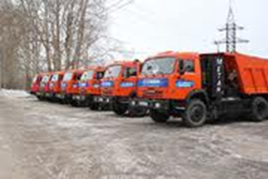
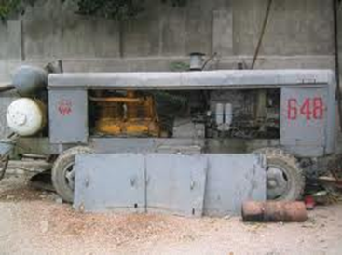
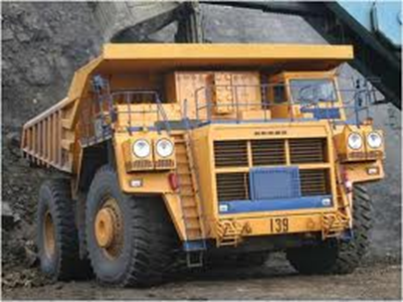
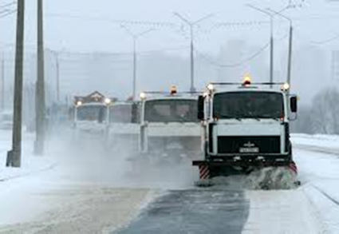
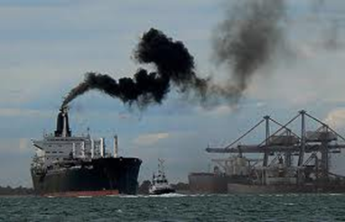
Scope of the Project in Terms of Emission Sources
On-road mobile sources:
Cars, Buses, Trucks.
Off-road vehicles:
Mining, Locomotives, Construction vehicles, Farming equipment.
Stationary: Diesel generators
Marine sources: Port, Ships.

Slide 6
Inventory Approach

Slide 7
Activity Data Collection (On-Road Transport)
Video cameras and limited parking lot surveys to get vehicle distribution data.
Additional data for heavy-duty trucks and buses, including: government fleet data, tax data, MSTU mechanic shop data (including data on passenger vehicle as well), and data from major companies in the region.
GPS loggers to get average speed and travel pattern for different types of vehicles.
Collect year-round data as travel patterns vary from winter to summer.
Compare findings to vehicle registry data to assess the likely total size and composition of the vehicle fleet.

Slide 8
Selection of Murmansk as the Target for the Inventory
Diesel emissions from within the Russian Arctic contribute substantially to total Arctic concentrations of BC;
Murmansk biggest city above the Arctic circle, population 300,000;
Murmansk relatively warm because of Atlantic waters, making use of diesel more feasible;
Relatively high quality regional statistics and data;
Strong local government support for this effort;
Experienced local partners.

Slide 9
Diesel Consumption in Murmansk Region, 2012: Top-Down and Bottom-Up Approaches*
Activity | Diesel use (tons)
On-road transport * | 65,100
Mines | 139,000
Locomotives | 21,200
Construction | 4,100
Agriculture | 1,300
Diesel generators, including: | 8,800
Small generators for commerce and services * | 7,100
Off-grid generators * | 1,700
Fishing (in Russian territorial waters), including: | 3,000
Large and medium vessels * | 2,500
Small boats * | 500
Total | 242,500
* - bottom-up calculations

Slide 10
PM_{2.5}, BC and OC Emissions in Murmansk Region (metric tons)
Activity | PM_{2.5} | BC | OC
On-road transport | 98.9 | 53.7 | 36.2
Mines | 450.5 | 279.3 | 83.8
Locomotives | 30.5 | 22.3 | 4.5
Construction | 15.6 | 12.0 | 2.4
Agriculture | 5.0 | 3.9 | 0.8
Diesel generators | 35.2 | 27.1 | 5.4
Fishing (in Russian waters) | 16.5 | 5.1 | 1.0
Total | 652.3 | 403.4 | 134.1

Slide 11
On-Road Transport
Data sources on vehicle fleet and activity: registry, parking lot surveys, vehicle inspection station, video surveys, GPS logger data, municipal data.
Highlights:
Share of diesel cars – 12%;
The share of vehicles with emissions controls is higher than shown in the registry;
Only 40-50% of vehicles are in use in Murmansk City;
Euro 0 trucks are the major source of BC emissions.

Slide 12
BC Emissions from On-Road Vehicles in Murmansk City (tons per year)
Note: COPERT-IV model with NIIAT emission factors for hot operation stage.

Slide 13
Breakout: Cold Start and Hot Stage Emission in Murmansk City (tons per year)
Note: COPERT-IV model with NIIAT emission factors.

Slide 14
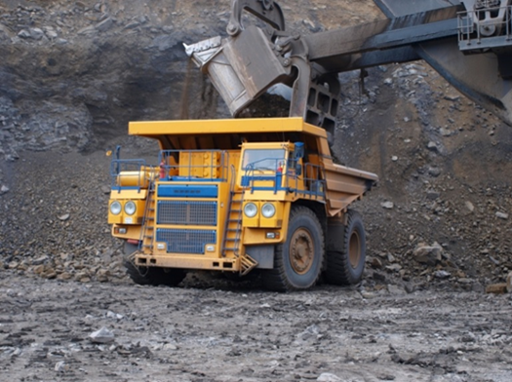
Mining Industry
There are 4 large open-pit mines in Murmansk Region;
Fuel consumption:
top-bottom approach -139,013 tons;
bottom-up approach – 138,554 tons.
Sources of BC emissions:
mining haul trucks;
shovels, bulldozers, excavators;
supplementary vehicles;
drilling equipment

Slide 15
Mining Trucks
Mining vehicles consume 85% of diesel in open pit mines;
Most BELAZ trucks are equipped with Cummins engines;
88% of Cummins engines are Tier 0;
Caterpillar and Komatsu trucks might have cleaner engines;
Total BC emissions by mines – 279.3 tons.

Slide 16
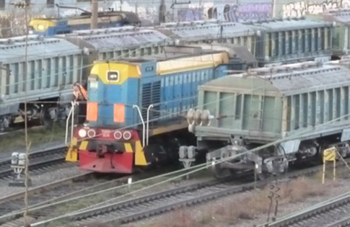
Locomotives
The most popular diesel locomotives are Soviet- or Russian-made with a power output of 882 or 1,500 kW;
Locomotives do not have any emission controls and are old;
Emission factor for locomotives: 1.44 g PM2.5/kg fuel;
BC emissions by locomotives:
22.3 tons per year.

Slide 17
Construction and Road Management
Off-road vehicles in the construction industry used 3,205 tons diesel fuel;
Road management companies used 865 tons of fuel;
We used EMEP-EEA emission factors:
- 4.038 g PM_{2.5} /kg fuel for construction vehicles without controls;
- 3.551 g PM_{2.5} /kg fuel for road management equipment without controls;
- 0.967 g/kg fuel for equipment with controls.
Total BC emissions – 12.0 tons per year.

Slide 18
Fishing
Fishing companies mainly operate in international waters;
Fishing vessels called into the Murmansk Fishing Port 1,713 times in 2012;
We analyzed emissions from the port to the edge of Russian territorial waters (24 +12 miles);
Engine load – 60%. BC emission factor – 0.35 g/kWh;
BC emissions from large and medium fishing vessels are 4,277 kg; BC emissions by small fishing boats are 840 kg per year;
Total BC emissions – 5.1 tons per year.

Slide 19
Diesel Generators
Three categories:
Generators and heaters that small market shops and service providers operate in settled areas;
Off-grid generators;
Back-up generators.
Total emissions of BC from generators -
26.3 tons per year.

Slide 20
Approximate extrapolation of Black Carbon Emissions from Diesel Sources in Russia (2010)
Sector | Diesel, million tons | BC emissions, tons
On-road transport * | 17.3 | 31,100
Agriculture and forestry | 2.8 | 8,200
Industry | 2.6 | 5,600
Other sectors | 2.9 | 11,800
* - Three were 5,181,200 diesel vehicles registered in Russia in 2010. We used NIIAT fuel-based emission factors.
Total BC emissions in Russia from all diesel sources in 2010 estimated to be 56,700 metric tons.

Slide 21
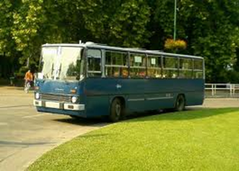
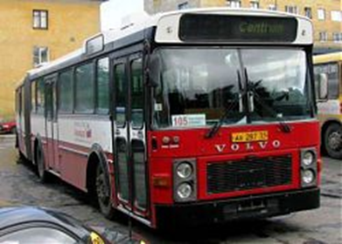
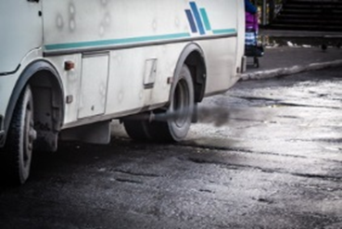
Bus Company: Murmanskavtotrans (MAT)
Largest private transport company in the Murmansk Region;
Intercity routes, and recently won tender for suburban routes;
MAT owns about 200 buses;
Most buses: Inefficient, Euro 0 and Euro I ecological classes. Only 19 buses before fleet upgrade were in Euro III and Euro IV classes.

Slide 22
MAT Bus Fleet Upgrade
Attended project Emissions Inventory workshop in Murmansk in April 2013 and made decision to lease new buses in 2013;
Phase 1, 2013: leased 29 new Euro V buses and retired 28 old Euro 0 buses;
Phase 2, 2014: Postponed due to economic crises, but
Catalyzed other companies to update their fleet: the municipal company Electrotransport also purchased 37 new Euro IV buses.

Slide 23
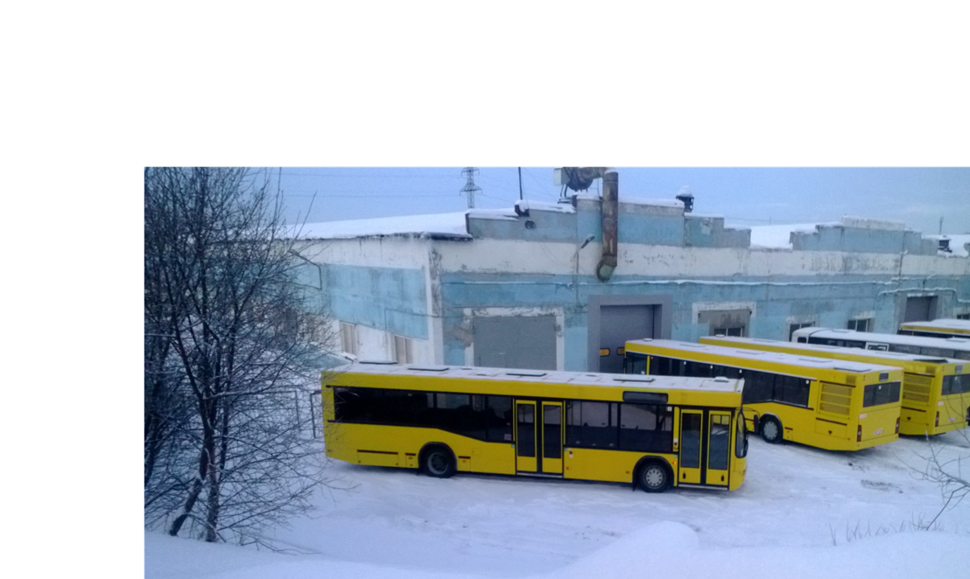
New Buses Began to Arrive in December 2013

Slide 24
MAT Bus Fleet Upgrade Benefits
Replacing the Euro 0 buses with Euro V models allowed Murmanskavtotrans to reduce black carbon emissions by 90%, or 1,050 kg per year
Social benefits: Reduction of health risks; increased reliability of the bus fleet and customer satisfaction,
Economic benefits: lower operating costs; less operations and maintenance costs required.
Improved environmental quality.
More reliable, sustainable public transportation.

Slide 25
Top Policy Conclusions
Off-road vehicles represent an important opportunity for additional emission reductions; regulation is required to achieve these reductions;
On-road vehicle emission control regulations have had a strong positive impact;
Fleet upgrades play an important role in emission reductions;
Comprehensive government policy is needed, including development of air quality monitoring system.

