Slide 1
Insights on the Agricultural Emission Estimation (AgrEE) prototype tool
Manjola Banja, Federico Pagani, Enrico Pisoni, Monica Crippa
Air and Climate Unit, Joint Research Centre, Ispra
TFEIP Agriculture and Nature Expert Panel – 4 May 2021, webinar

Slide 2
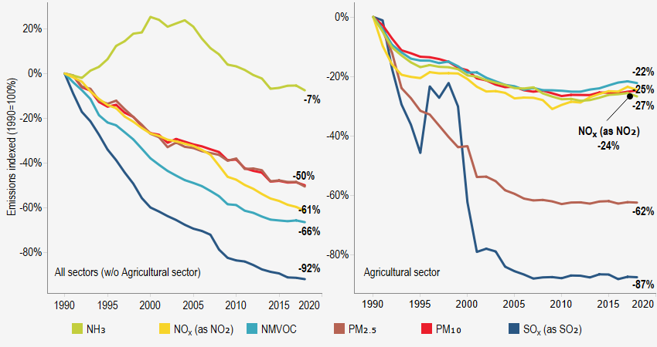
Background
Air pollutant emissions from agriculture in EU have decreased much less than in other sectors.
Emission reductions are required for agriculture:
-Industrial Emissions Directive: e.g. for large pig and poultry farms, but not for cattle (which are the highest emitters for NH3)
-National Emission reduction Commitments Directive sets national reduction commitments for SO2, NOx, NMVOC, NH3, PM2.5

Slide 3
How to improve agricultural emission estimates
Project launched by DG ENV in collaboration with the Joint Research Centre (Ispra) for the time period 2020-2021 to “Support the improvement of national emission inventories for the agricultural sector in Europe”
Providing more robust emissions inventories under the National Emissions reduction Commitments Directive (NECD), for compliance checking, as well as for the development of emissions projections and policies and measures under the National Air Pollution Control Programmes.
Development of a tool for agricultural emissions inventories through the involvement and data sharing from MS to incorporate very local information on agricultural techniques and practices. The tool could already serve the next cycle of the related NECD reporting obligations.
Online technical platform for emission factors (EFs) and activity data related to the different agricultural sub-sectors.

Slide 4
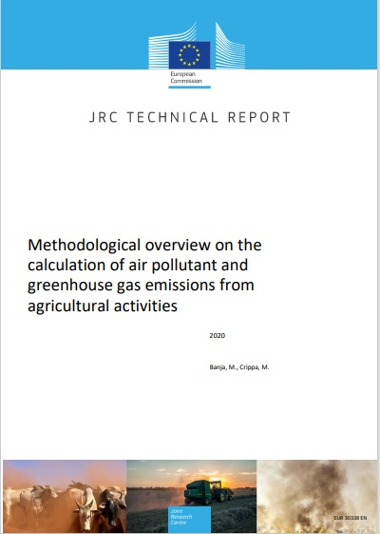
Region of interest: EU27+UK
Period covered: 1990-2018
Air pollutants: NH3, NOx (as NO2), NMVOC, PM10, PM2.5
Greenhouse gases: CH4, N2O
Enteric Fermentation
Manure Management
Agricultural Soils
Field burning of agricultural residues

Slide 5
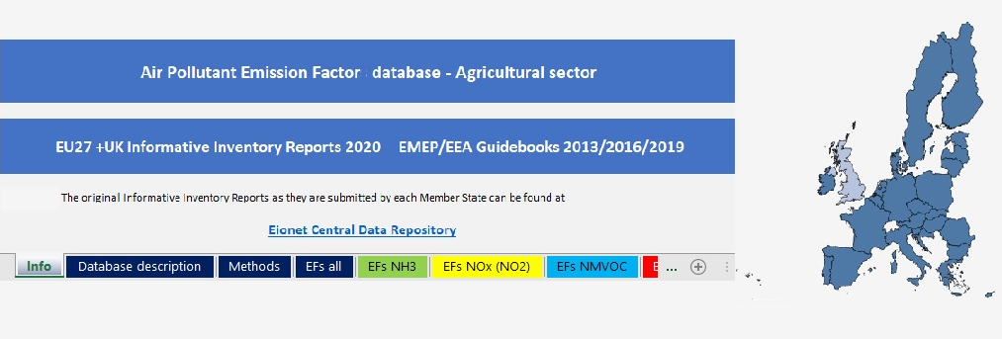
Compilation of the emission factor and activity data database
Sources: EMEP/EEA Guidebooks (2013, 2016, 2019), IIRs 2020
Review and check by MS during period January – March 2021
Emission Factor Type: Default + Country Specific – Expanded after MS review
Activity data: Expanded after MS review
Air pollutants: NH3, NOx, NMVOC, PM10, PM2.5
All agricultural subsectors and categories

Slide 6
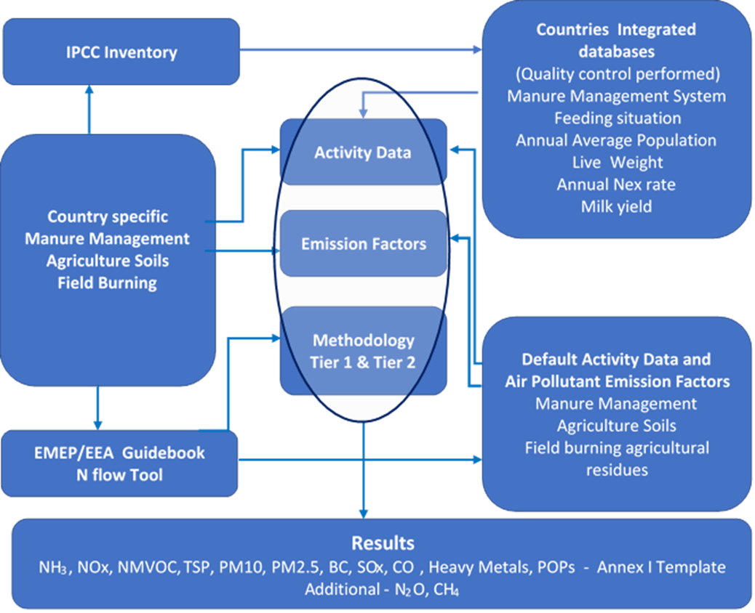
A user-friendly tool to be used by inventory compilers

Slide 7
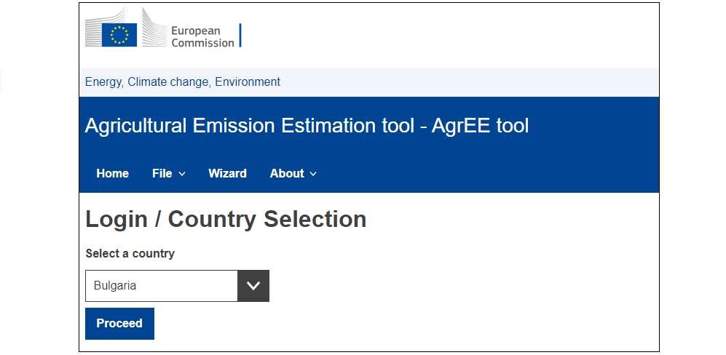
Prototype tool for emission computation (1)

Slide 8
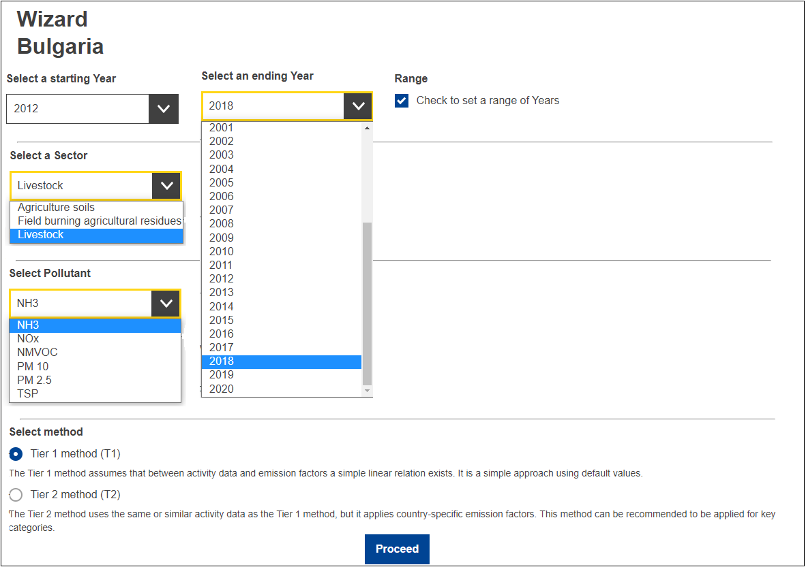
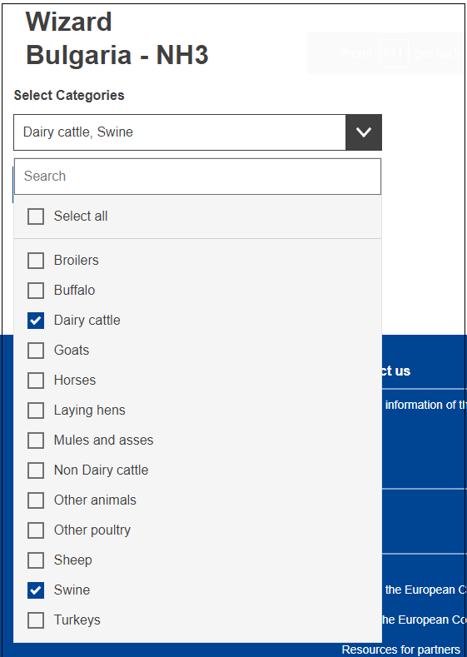
Prototype tool for emission computation (2)

Slide 9
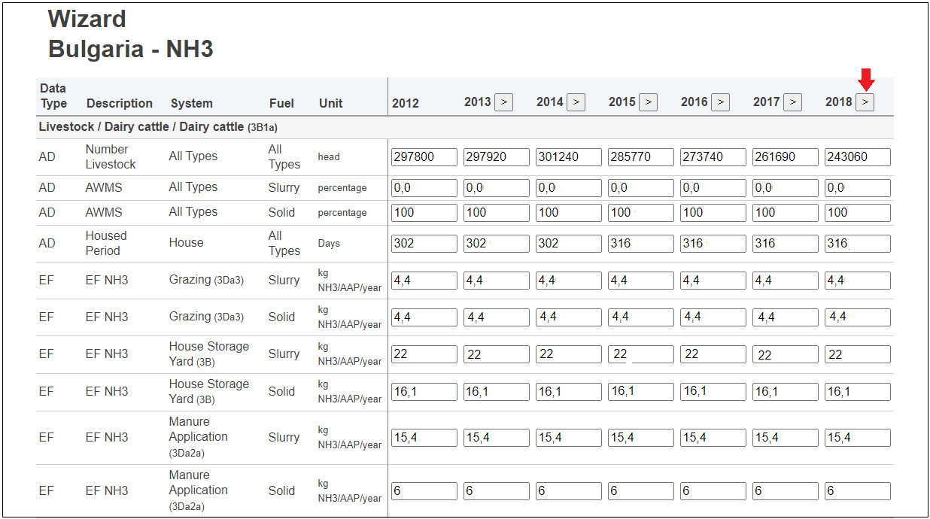
Prototype tool for emission computation (3)
Copy from previous year

Slide 10
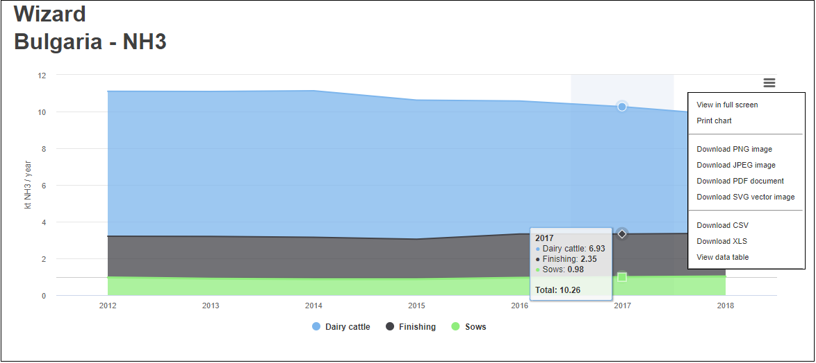
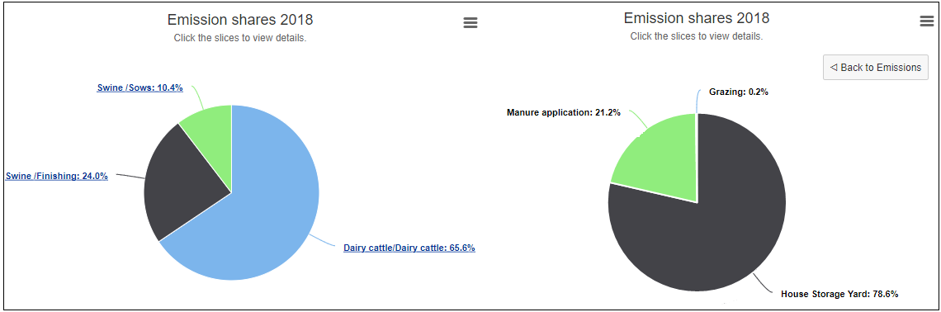
Prototype tool for emission computation (4)

Slide 11
Main features and added value of AgrEE
User-friendly, flexible, allowing data manipulation (e.g. AD, EFs),
Ensures consistency of emission calculation for all MS in line with the EMEP/EEA Guidebook 2019. The default AD and EFs will be kept updated, which means less time consuming for the user/inventory compiler.
Covers all categories of emissions in Manure Management, Agriculture Soils, Field Burning.
Provides emissions for all relevant pollutants from agriculture regulated under the NECD (NOx, NMVOC, NH₃ and PM2.5), CH4 and N₂O for each MS.
Trend analysis, compare results from different methods, EU overview, relative contributions, etc.
Possibility for MS to move towards higher tiers for those emission categories and air pollutants that were so far calculated applying Tier 1 method

Slide 12
Main features and added value of AgrEE
It will allow MS to report for emissions categories that they possibly do not yet cover,
The information needed to apply Tier 2 methodology will be gathered for those MS that currently apply Tier 1 for all or several categories. In case some pieces of information are missing, assumptions/suggestions will be provided to other sources (models, literature, data from related countries).
The tool will be fed also by the activity data and emission factors sourced from EDGAR database (e.g. Tier 2 emission factors for field burning of agriculture residues) and other sources/literature.
The tool will enable Member States to extract their emissions and data as requested under the NECD reporting template.
The tool can provide the possibility to take into account the effect of abatement measures for certain systems and categories

Slide 13
The way forward
Tool implementation (both Tier 1 and Tier 2) – May 2021
Preparation of needed input to run Tier 2 method – May 2021
For those MS that currently apply Tier 1 for all or several categories
Tool testing, feedback collection and implementation – May - June 2021
Tool testing and validation will be done in collaboration with MS and DG ENV. Volunteers are welcome!
Tool finalisation -The tool is aimed to be finalised by autumn 2021, so that Member States can use it for their NECD inventory reporting deadline of February 2022.
The tool is totally optional. No obligation to use

Slide 14

Thank you
© European Union 2020
Unless otherwise noted the reuse of this presentation is authorised under the CC BY 4.0 license. For any use or reproduction of elements that are not owned by the EU, permission may need to be sought directly from the respective right holders.
Slide xx: element concerned, source: e.g. Fotolia.com; Slide xx: element concerned, source: e.g. iStock.com

